Slide 1
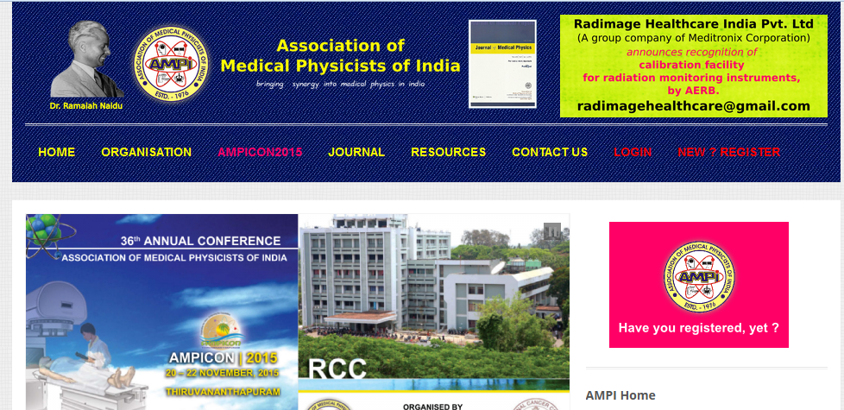

Slide 2
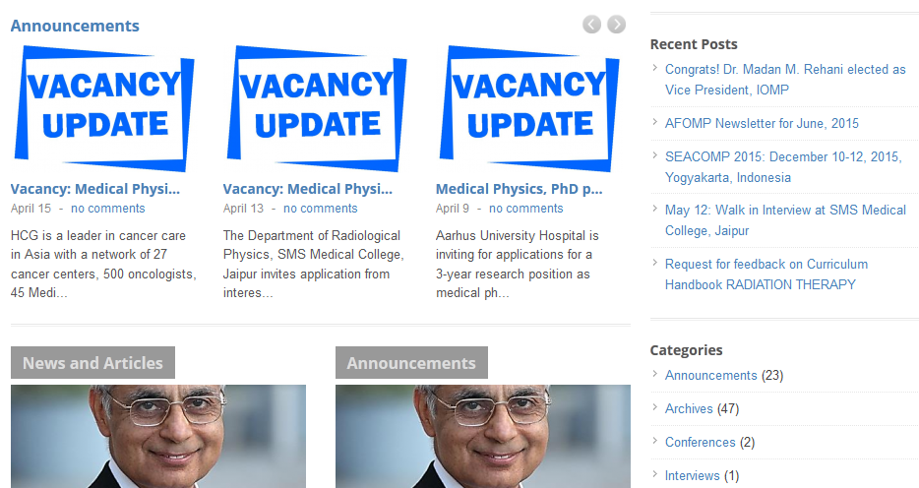

Slide 3
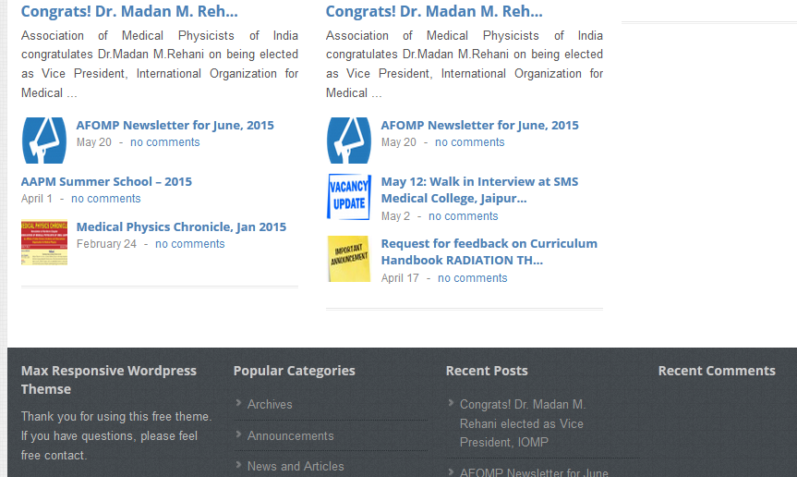

Slide 4
To be Linked
Recent medical Physics activities
Links to international organization/india bangladesh/ICTP/AAPM/IOMP/IAEA
Link to different cancer hospital in Nepal.
Link to onconews
Tour and entertainment in Nepal
Hotels/Treking/travel agency in NEPAL
Some major destination…. PashupatiNath,Lumbani,Mt verest,Annapurna trek,Saurara,Pokhara
NAMP members list.

